Slide 1



Design of an Automatic Adjustable Wind Tunnel Diffuser
Arizona/NASA Space Grant Symposium
Nicolas Tan, Roman Anthis
Advisor Dr. Jesse C. Little
The University of Arizona
Aerospace and Mechanical Engineering
Partially funded by: AFOSR and ONR
Notes:
JL: use same logo locations for the second slide on title slide, you can leave the upper left corner blank

Slide 2


Acknowledgements
James Threadgill – Research Scientist
Dale Drew – Instrument Maker
Sathyan Padmanabhan – PhD Student
Adrian Guerra – Master’s Student
Ashish Singh - PostDoc
Notes:
Explain Nozzle and Test section here
Mention what the throat is point to it
Area ratio sets the Mach number - minimum
Area ratio graph and show trend
JL: make tunnel picture bigger if possible

Slide 3
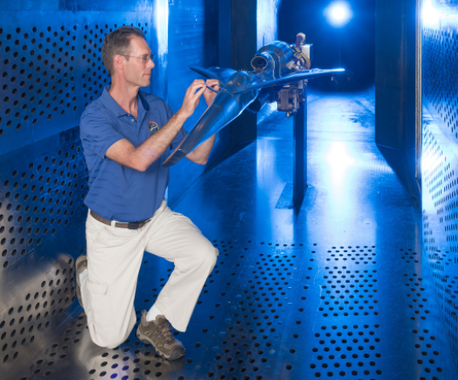
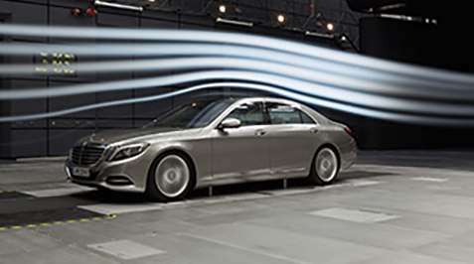
Wind Tunnels
Types: Subsonic (M < 1), Transonic (M = 1)
Supersonic, Hypersonic (M > 1)
Image Credit: Siemens
Image Credit: Nasa
Notes:
Explain Nozzle and Test section here
Mention what the throat is point to it
Area ratio sets the Mach number - minimum
Area ratio graph and show trend
JL: make tunnel picture bigger if possible

Slide 4
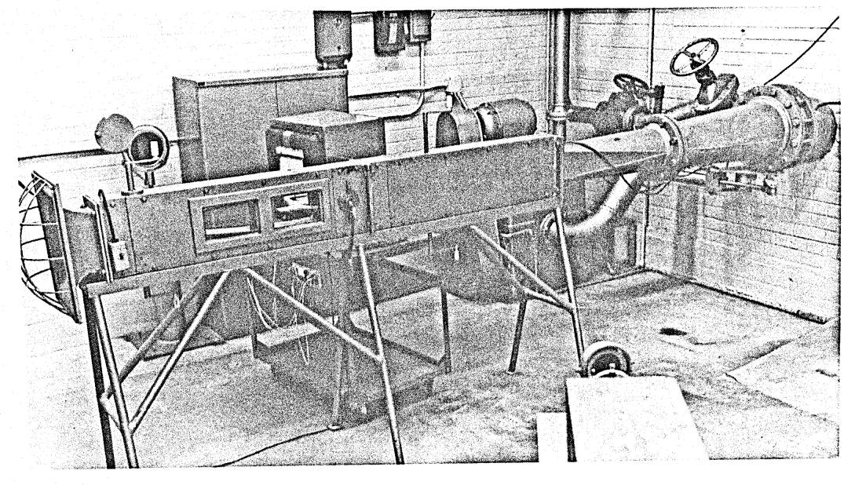
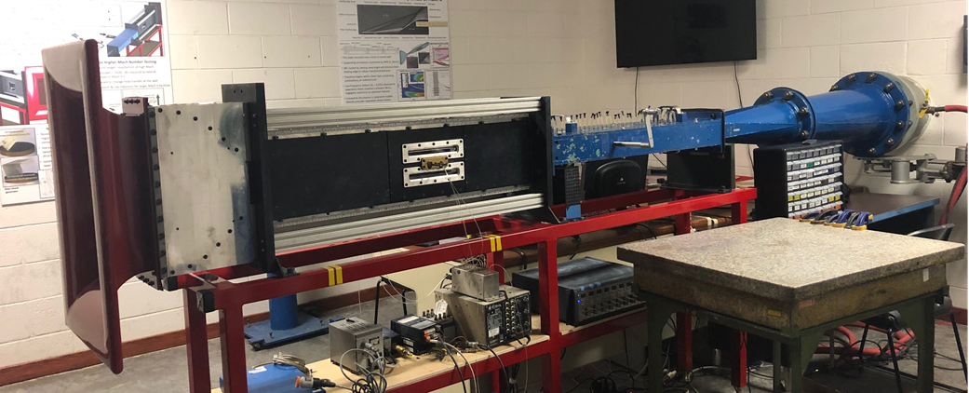
Turbulence, Flow and Control Laboratory (TFCL)
Indraft Supersonic Wind Tunnel (ISWT) in the University of Arizona
Built in the 1960’s
Retrofitted to support modern hardware & software
Image Credit: James Dozier, University of Arizona, TFCL, University of Arizona
Notes:
Explain Nozzle and Test section here
Mention what the throat is point to it
Area ratio sets the Mach number - minimum
Area ratio graph and show trend
JL: make tunnel picture bigger if possible

Slide 5
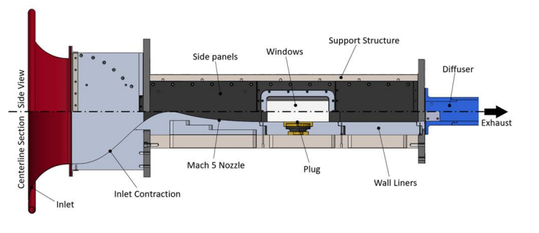
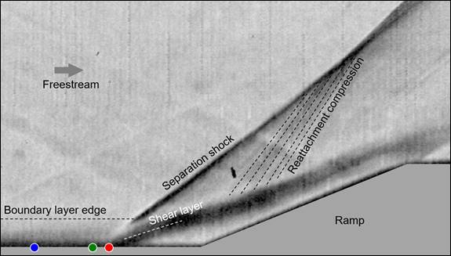
Turbulence, Flow and Control Laboratory (TFCL)
Indraft Supersonic Wind Tunnel (ISWT) in the University of Arizona
Components and Test section
High Speed Schlieren Imaging
Image Credit: James Threadgill, University of Arizona, Ethan Bolze, University of Arizona
Notes:
Explain Nozzle and Test section here
Mention what the throat is point to it
Area ratio sets the Mach number - minimum
Area ratio graph and show trend
JL: make tunnel picture bigger if possible

Slide 6
Motivation
Wind Tunnel
Military & Commercial Applications
Aerial Vehicles
Missiles
Aircraft
Easier and faster access to space
Adjustable Diffuser
Increases Runtime
Longer runtimes means more research can be done
Repeatability at a wide range of Mach numbers
Notes:
Explain Nozzle and Test section here
Mention what the throat is point to it
Area ratio sets the Mach number - minimum
Area ratio graph and show trend
JL: make tunnel picture bigger if possible

Slide 7
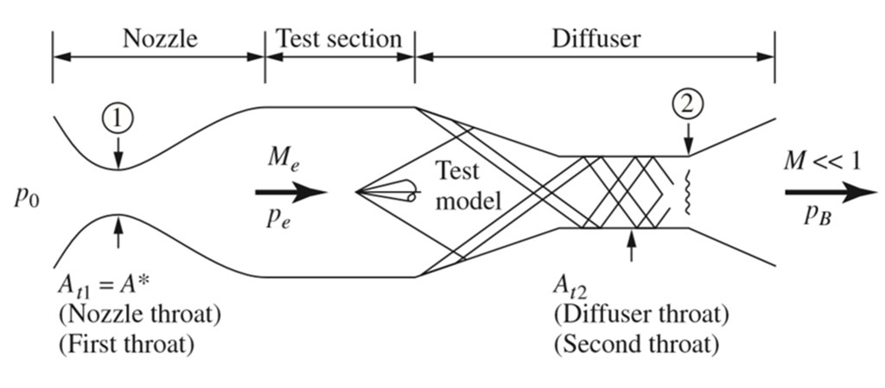
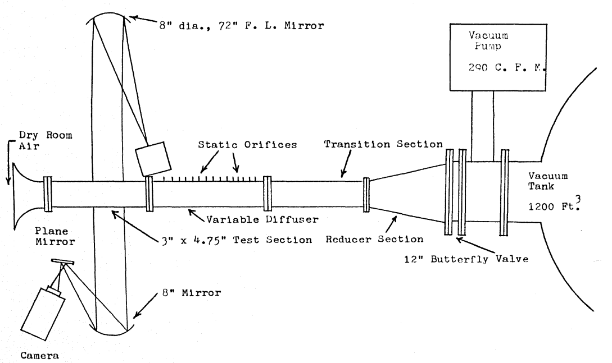
Supersonic Diffusers
Image Credit: James E,A, Gas Dynamics
The goal of a diffuser is to transform kinetic energy into potential energy with minimum losses in total pressure.
Image Credit: James D., University of Arizona
Notes:
Explain Nozzle and Test section here
Mention what the throat is point to it
Area ratio sets the Mach number - minimum
Area ratio graph and show trend
JL: make tunnel picture bigger if possible

Slide 8
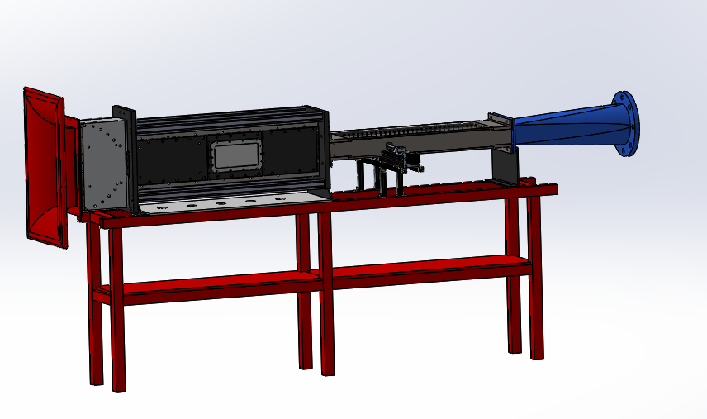
Automated Adjustable Wind Tunnel Diffuser Design
Notes:
Explain Nozzle and Test section here
Mention what the throat is point to it
Area ratio sets the Mach number - minimum
Area ratio graph and show trend
JL: make tunnel picture bigger if possible

Slide 9
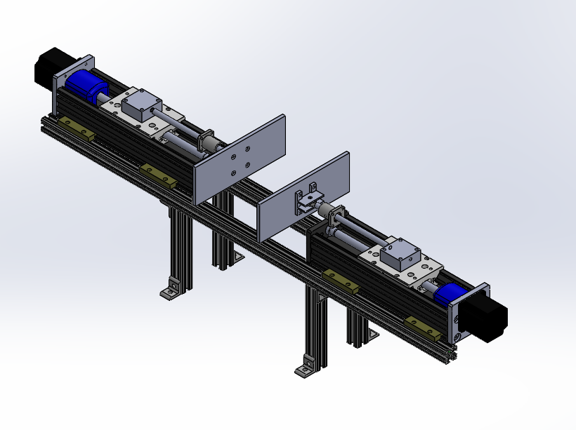
Automatic Adjustable Wind Tunnel Diffuser Design
Bill of Materials
Bill of Materials
Bi-Slide Assembly
Bi-Slide Cleat
Linear Motion Shaft
Flange Mounted Housing
- Self-Aligning Linear Ball
Bearing
Mounting Plate
Diffuser Wall Mount
Linear Motion Shaft
Diffuser Wall Mount
Bi-slide cleats
Flange Mounted Housing
Bi-slide assembly
Notes:
Explain Nozzle and Test section here
Mention what the throat is point to it
Area ratio sets the Mach number - minimum
Area ratio graph and show trend
JL: make tunnel picture bigger if possible

Slide 10
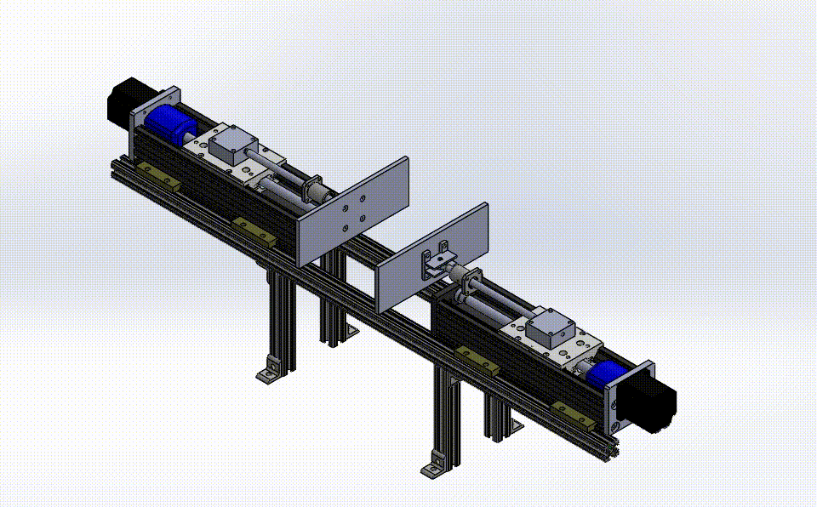
Automatic Adjustable Wind Tunnel Diffuser Design
Detailed Design
Linear Shaft
Replaces manual crank shaft.
Connected to Ball Joint Rod End to account for diffuser wall flexing.
Lateral Movement controlled by linear bearing housing.
load capacity of 300 lbs. (136kg.)
Notes:
Explain Nozzle and Test section here
Mention what the throat is point to it
Area ratio sets the Mach number - minimum
Area ratio graph and show trend
JL: make tunnel picture bigger if possible

Slide 11
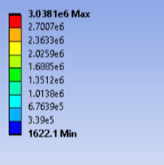
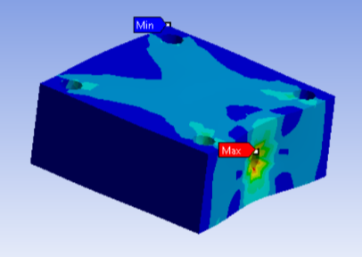
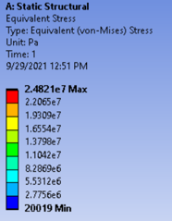
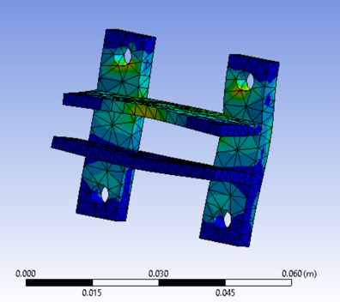
Automatic Adjustable Wind Tunnel Diffuser Design
Detailed Design
Connection Points and Mounts
Replaced Steel with Aluminum 6061 based on structural simulations
Reduced Cost and Improved Machinability
Notes:
Explain Nozzle and Test section here
Mention what the throat is point to it
Area ratio sets the Mach number - minimum
Area ratio graph and show trend
JL: make tunnel picture bigger if possible

Slide 12
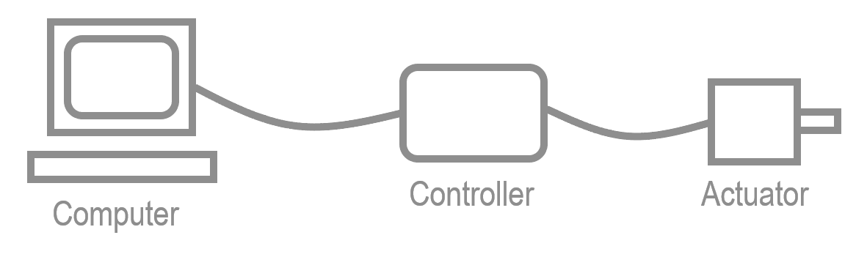
Overview
Notes:
Explain Nozzle and Test section here
Mention what the throat is point to it
Area ratio sets the Mach number - minimum
Area ratio graph and show trend
JL: make tunnel picture bigger if possible

Slide 13

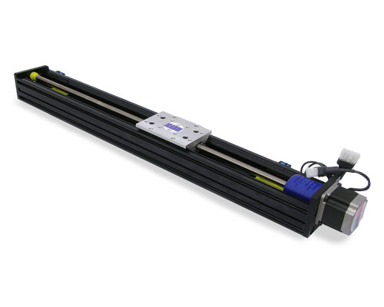


Actuator
Velmex BiSlide
Stepper motor turns lead screw
Slide moves linearly pushing on the side plates of the diffuser
Varies the diffuser throat area by pushing in bendable plates
Source: Velmex
Notes:
Series of Oblique shock that turns into a weak shock for less pressure losses
Same process happens in ramjets – air breathing propulsion

Slide 14
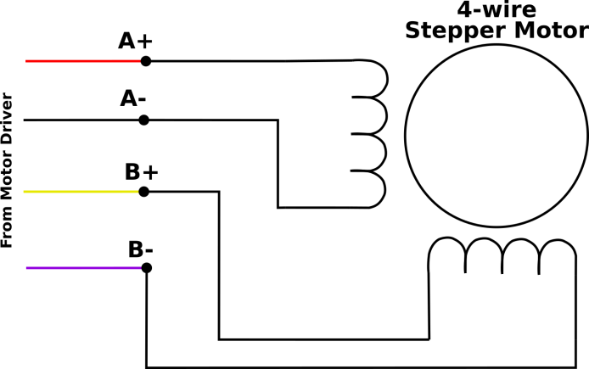
Actuator
What is a stepper motor?
Coils need to be powered and unpowered to move the stepper motor
Two-phase motor
Two sets of coils to power
Driver circuit required to function
Manual control is impractical
Source: https://buildbotics.com/wiring-stepper-motors/
Notes:
Series of Oblique shock that turns into a weak shock for less pressure losses
Same process happens in ramjets – air breathing propulsion

Slide 15

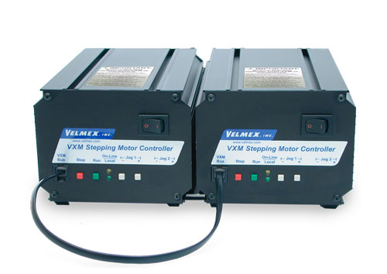
Controller
Potential Controller Choices
VXM-1,VXM-2,VXM-1-1, Other
First three work well with stepper motor and are easy to configure
VXM-2 can control two motors simultaneously
Source: Velmex
Notes:
More efficient because: tank fills up with less pressure, takes longer to break down. Less wait time between runs waiting for vacuum tank to empty.
Higher Mach -> larger pressure difference ->p decreases more across the shock -> vacuum tank does not fill up as fast
Pf/p0 is the important factor
Larger p ratio larger t

Slide 16
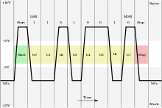
Controller
How does it work?
Messages are passed from the computer to the controller using the RS-232 Communication Protocol
An interpreter circuit decodes the message
The stepper motor is controlled depending on the sent message
Source: https://en.wikipedia.org/wiki/RS-232
Notes:
Torque = 2.828 ft-lbf = 33.936 in-lbf
Arm ~ 10 inches
Force = 3.2 pounds?
JL: make bulleted text all same size

Slide 17
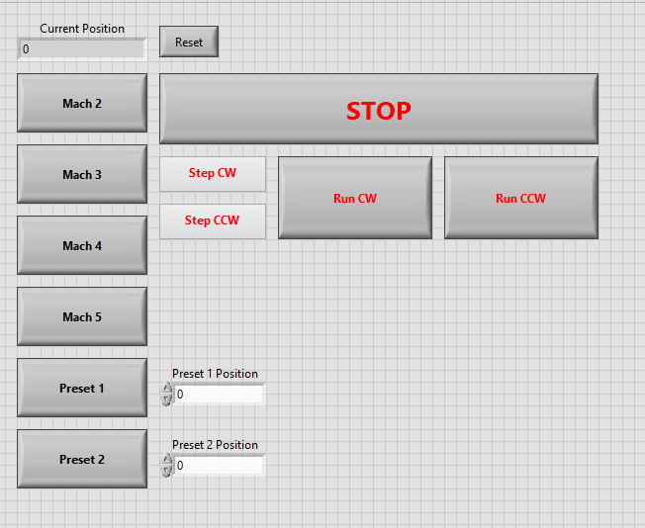
Computer
How are the codes sent?
LabVIEW script sends codes
Backend code configured to send these codes
GUI makes it easy to use
Notes:
JL: make bulleted text all same size

Slide 18
Next Steps
Assembly
Safety Measure
Test speeds
Test travel distances
Features for Users
More quality-of-life features
Notes:
All the analysis is for inviscid, viscous effects (SBLI) are important
Get schlieren photo, mean picture of SBLI
PIV – flow filled with particles and visualized with a laser sheet and camera
Want it to run longer for SBLI – state as an example
Shock has an adverse pressure gradient causes BL to oscillate and separate
High heating at separation and reattachment – localized regions of high heating
High pressure and heating leads to damage
JL: I added some different figs. Just rearrange size to fit. Note sure if you still need SBLI schematic. Your call, if you keep then make bigger, text is hard to see. I think you are fine with PIV and schlieren alone.is hard to see. I rearranged text a bit. To give more space for new figs. CITE FIGS.

Slide 19
Thank you!
Notes:
All the analysis is for inviscid, viscous effects (SBLI) are important
Get schlieren photo, mean picture of SBLI
PIV – flow filled with particles and visualized with a laser sheet and camera
Want it to run longer for SBLI – state as an example
Shock has an adverse pressure gradient causes BL to oscillate and separate
High heating at separation and reattachment – localized regions of high heating
High pressure and heating leads to damage
JL: I added some different figs. Just rearrange size to fit. Note sure if you still need SBLI schematic. Your call, if you keep then make bigger, text is hard to see. I think you are fine with PIV and schlieren alone.is hard to see. I rearranged text a bit. To give more space for new figs. CITE FIGS.

